Slide 1
“Bus Terminal Using modern OpengL”
Md Mizanur Rahman
Roll:1807063
Department of
Computer Science and Engineering

Slide 2
Outline
Keyboard Control (lighting)
Keyboard Control (View)
Keyboard Control (Bus and Door)
Features

Slide 3
Keyboard Control (Lighting)
Press 1: Directional Light off/on
Press 2: Point Light 1 off/on
Press 3: Point Light 2 off/on
Press 4: Spot Light 1 off /on
Press 8: Spot Light 2 off/on
Press 5: Ambient off/on
Press 6: Diffuse off/on
Press 7: Specular off/on

Slide 4
Keyboard Control(View)
Press W: Forward
Press S: Backward
Press A: Left
Press D: Right
Press E: Up
Press R: Down
Press Q: Roll left
Press Z: Roll Aright
Press X: Pitch up
Press C: Pitch down
Press Y: Yaw right
Press V: Yaw left

Slide 5
Keyboard Control(BUS and Door)
Press O: Open Ticket Counter Door
Press P: Open Bus Door
Press M: Bus Movemnt Horizontal
Press B: Bus Movement by Camera

Slide 6
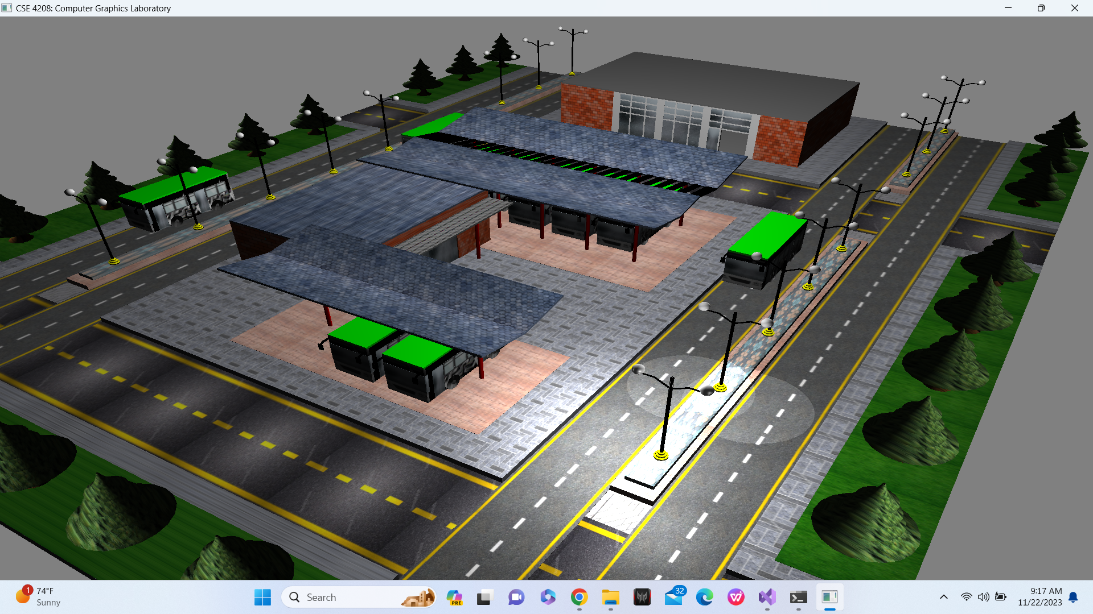
Features
The Top view of Bus terminal
Fig 1: Bus Terminal

Slide 7
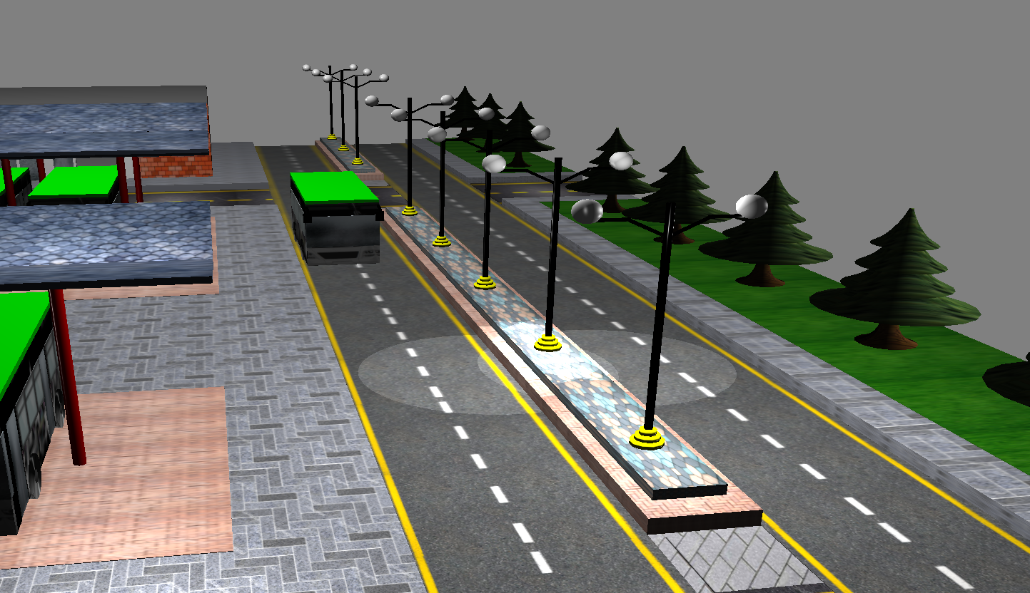
Features
The lamp post is build using cylinder and sphere
Fig 2: Road and Lamp Post

Slide 8
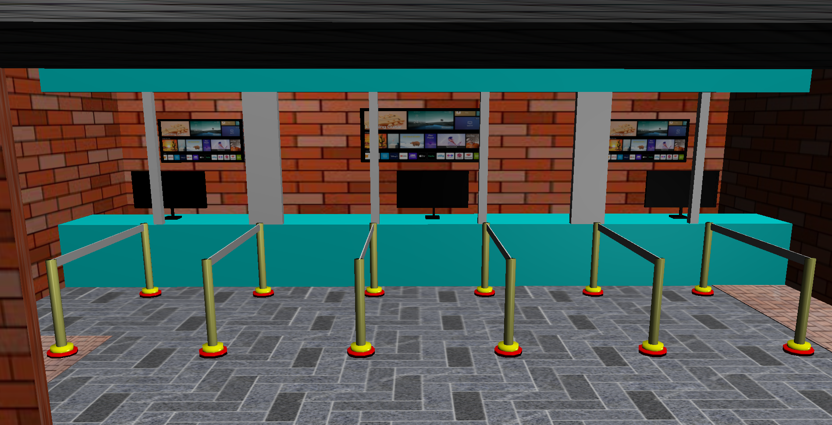
Features
The Bus Ticket Counter where passenger buy ticket
Fig 3: The Bus Ticket Counter

Slide 9
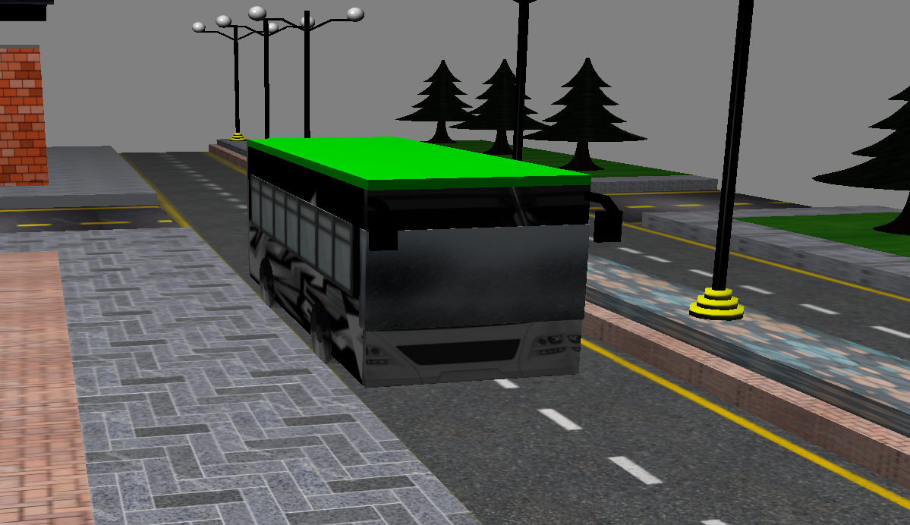
Features
The Bus can movement by camera movement
Fig 4: Bus

Slide 10
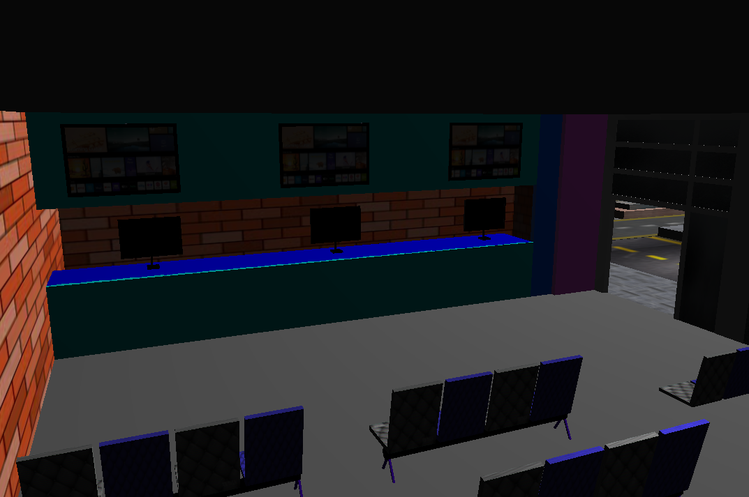
Features
Fig 5: Waiting Room

Slide 11
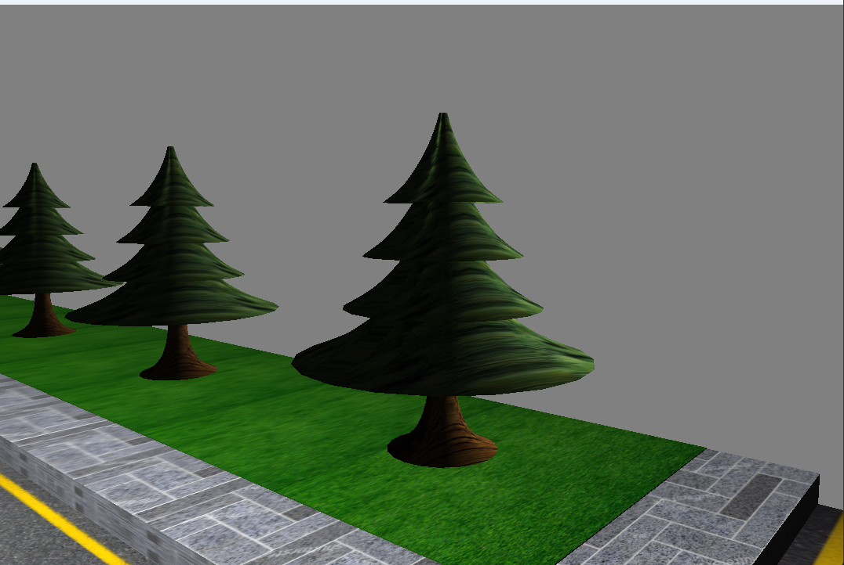
Features
Tree is made with Bezier curve.
Fig 6: Tree

Slide 12
Thank you

